Slide 1
PHY 105N

Slide 2
Looking Ahead
Half credit back assignment
Make Up Labs
Final Project

Slide 3
Half Credit Back Assignment
There will be a second resubmission for 1/2 credit back.
This may be a simple matter of correcting some mistakes in your analysis, conclusions, or the way you wrote up the notes. If so, feel free to go ahead and make the changes. You must Highlight the changes somehow so they are clear and resubmit it to your TA.
If you need to redo parts of the experiment to address the feedback you got on your report, you may do so during the make up weeks.
The assignment will be due December 8th by the end of the day

Slide 4
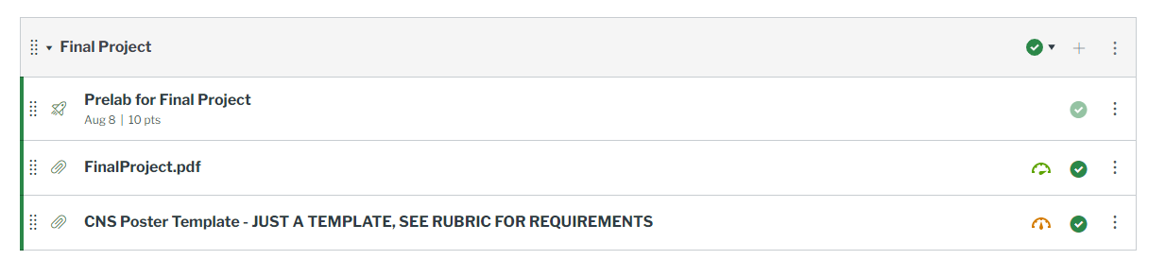
Final Project

Slide 5
Final Project
The project is explained in a manual just like a lab is. Key points:
Individual assignment!
Needs to be original – standard test is two major differences from any previous lab
Any physics topic is acceptable, including Physics I topics
There is only a Part 1, no Part 2 needed
Poster is the product, not lab notes

Slide 6
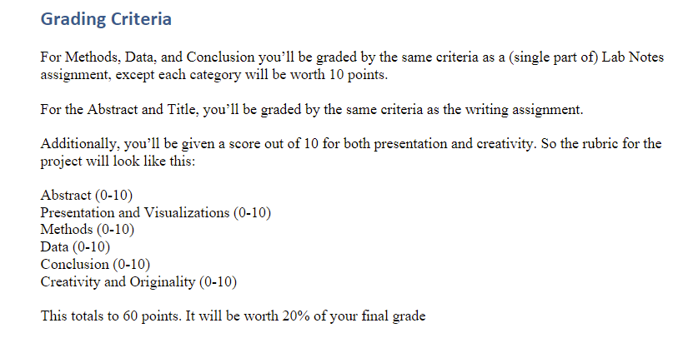
Final Project
The grading rubric is in the manual. It is meant to match previous assignments to the extent possible.

Slide 7
Final Project
Good examples of final projects:
-Student measured rotation rate of two different divers multiple times and compared the angular velocities with a t-score
-Student measured sound intensity vs. distance and found evidence of dissipation
-Student made friends with a geosciences professor and did radioactive dating on his rock collection
-Students studied refraction in glass. They did a linear fit to see if Sin(theta1)=n Sin(theta2)

Slide 8
Final Project
Bad examples of final projects:
-Student checked if their toothbrush is radioactive (this is just Part 1 of Geiger Counter lab)
→Instead, identify something which theoretically should or may be radioactive and check if it is.
-Student measured the speed of sound by finding the frequency and wavelength using a smartphone app and got “exact agreement”
→Instead pluck a string or vibrate a tuning fork etc. and measure frequency and wavelength independently, compare w/ velocity
-Student took a picture of himself playing a guitar, and wrote some text about how he measured frequencies and compared them to the manufacturer’s values
→Need to test a physics model, e.g. f=nc/2L

Slide 9
Deadlines
All make up labs, final projects, and resubmissions should be due December 8th, the last day of classes.

